Slide 1
An EPA Thriving Communities Initiative
Cycle 1 Application Launch & Overview

Slide 2

Closed Captioning is available
To enable closed captioning, click on the “CC” icon in your meeting/webinar controls.
Select “Show Captions”
Notes:
Shaivi

Slide 3
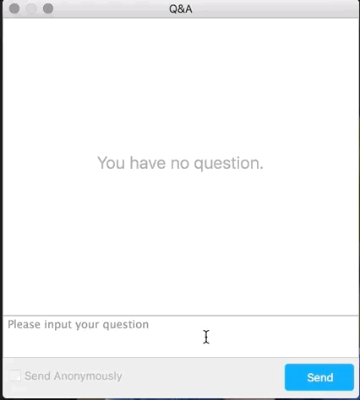
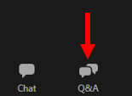
How to Ask a Question
Two ways to ask a question:
Use the Q&A box at the lower-left of your screen to chat with the presenter.
You may also email questions to mapejgrants@jsi.com after the webinar.

Slide 4
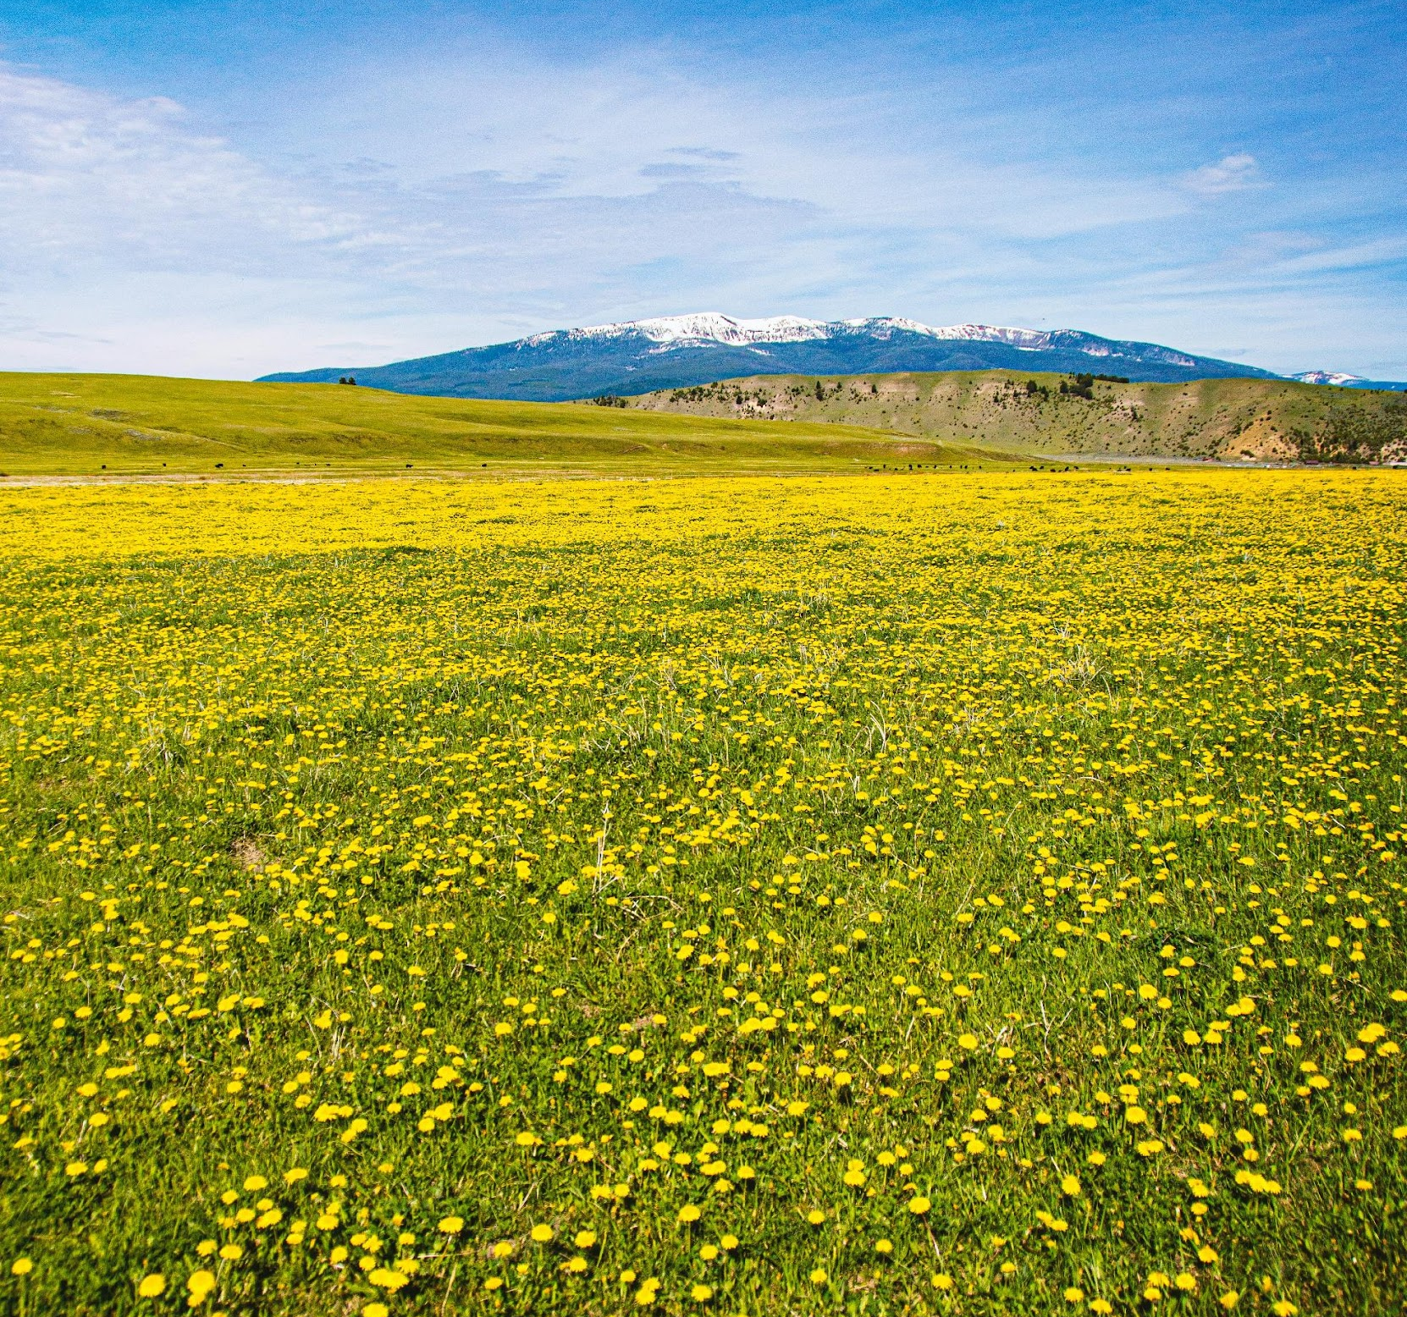
Agenda
Introduction to TCGM
  Who are we?
  What do we do?
Grant Overview
  Tiers
  Eligibility
  Timeline
  Example projects
  Additional considerations
Application Overview
  Competitive
  Non-competitive

Slide 5
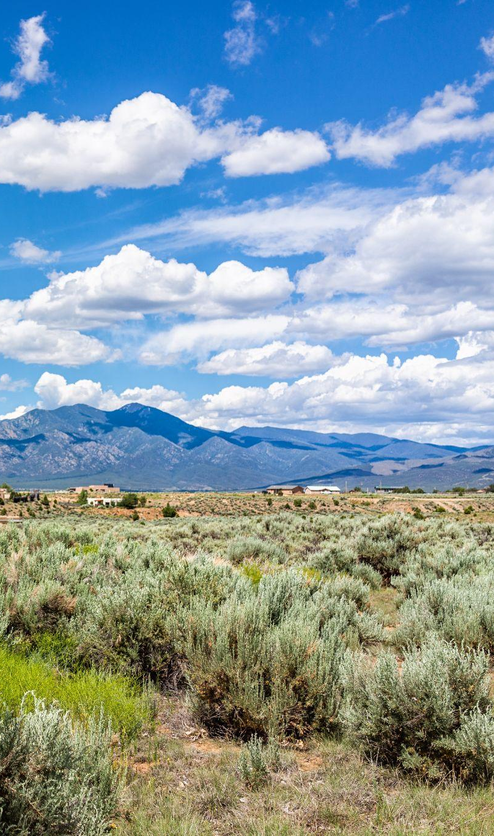
Overview: EPA Thriving Communities Grantmaking Program
Purpose: to reduce barriers and make it easier for small, community-based organizations to access federal environmental justice funds
Funding: $600 million from Inflation Reduction Act (IRA), the largest investment in climate action in history.
Who and what: Nationally 11 grantmakers covering all EPA regions will distribute thousands of grants over 3 years.

Slide 6
What is Environmental Justice?
Environmental justice, as defined by the EPA, is the just treatment and meaningful involvement of all people, regardless of income, race, color, national origin, Tribal affiliation, or disability, in agency decision-making and other Federal activities that affect human health and the environment so that people:
are fully protected from disproportionate and adverse human health and environmental effects (including risks) and hazards, including those related to climate change, the cumulative impacts of environmental and other burdens, and the legacy of racism or other structural or systemic barriers; and
have equitable access to a healthy, sustainable, and resilient environment in which to live, play, work, learn, grow, worship, and engage in cultural and subsistence practices.

Slide 7



MAP EJ Grants Hub & Partners
Who we are?
JSI Research & Training Institute, Inc. (Denver, CO) & community-based partner organizations across EPA Region 8.

Slide 8
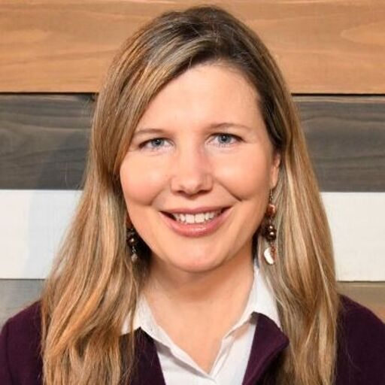









Meet the Team
Alexia Eslan
Project Director
Elizabeth White
Deputy Director
Meredith Lee
Grantmaking Director
Meghan Guevara
Senior Grant Manager
MT Grant Manager
Lesly Fajardo-Feaux
Senior Grant Manager
ND Grant Manager
Ali Witonsky
CO Grant Manager
John Karikas
WY Grant Manager
Molly Rafferty
SD Grant Manager
Savannah Smith
Tribal Grant Manager
Natalie Youssef
UT Grant Manager

Slide 9
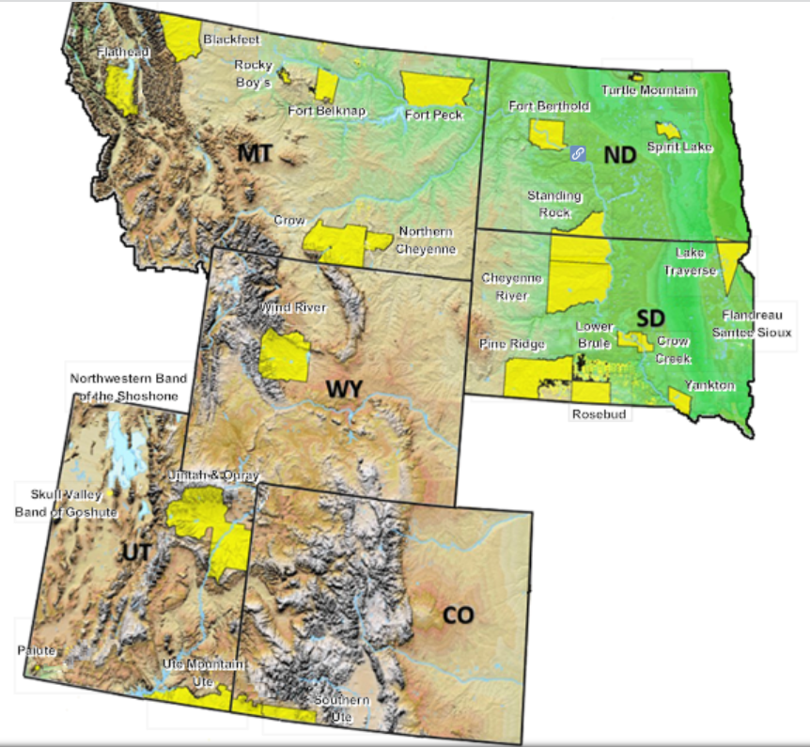
Overview: MAP EJ Grants Hub
Purpose: Provide $40 million in grants over 3 years to communities across EPA Region 8 (CO, MT, ND, SD, UT, WY, 28 Tribes) working on environmental justice efforts.
Goals:
Get money and resources to the environmental justice communities
Reduce the burden of getting and managing a federal grant
Strengthen the capacity of local organizations to support long-term sustainability
EPA makes no claim regarding the accuracy or precision of the data shown herein. This map is intended for reference purposes only and does not necessarily represent EPA’s position on Indian reservation boundaries or the Indian country status of any specific location.

Slide 10
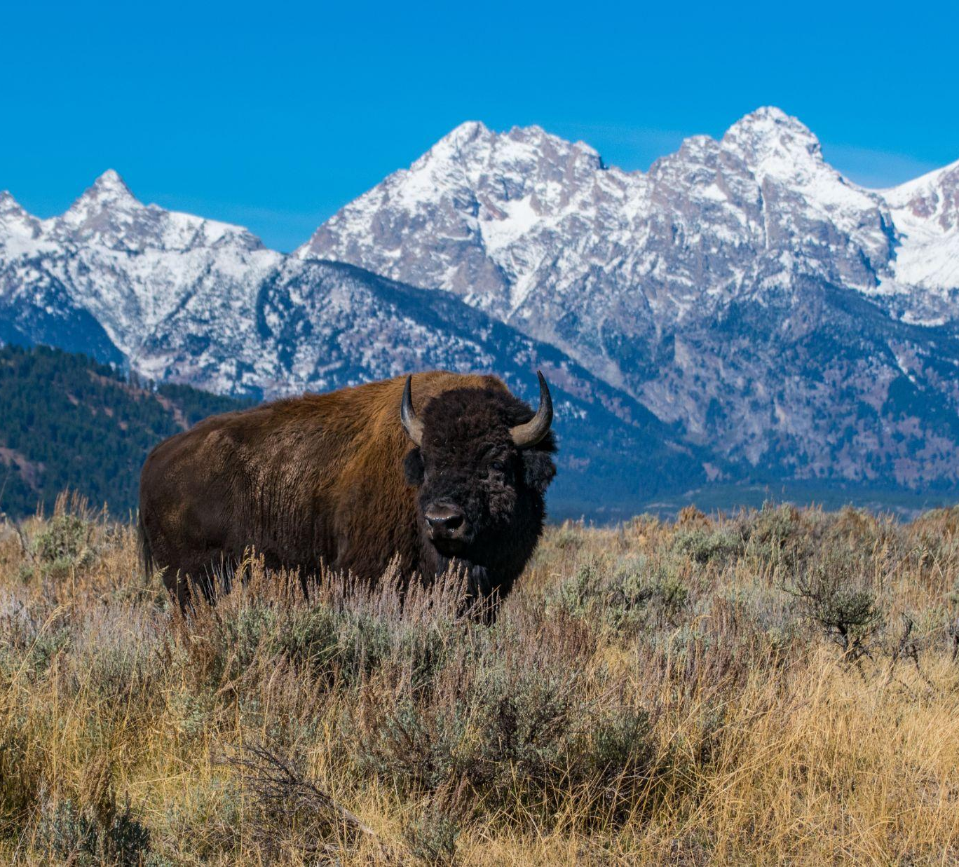
Grant Overview

Slide 11
Eligible Grant Activities
  Tier 1 Grants: Assessment | up to $150,000 | 1 Year
    Examples include: Research (that is incidental to the project design) • Sampling • Testing • Monitoring
    • Investigations • Surveys and studies • Public education
    + Pilot ten $75,000 noncompetitive fixed amount awards for severely capacity-constrained organizations
  Tier 2 Grants: Planning | up to $250,000 | 1-2 Years
    Examples include: Planning • Partnership-building • Public outreach and education • Coordination with community stakeholders to address environmental issues • Training activities for community organizations and community members • Projects and activities to spur community involvement (e.g., cleanups of vacant lots) • Smaller land purchases and acquisitions that require less than half of the total amount of subgrant funding
    Tier 3 Grants: Development | up to $350,000 | 2 Years
    Examples include: Project Development • Blueprints for construction or cleanup projects, schematics, and technical development • Work to get permits in place directly related to an environmental project • Smaller land purchases and acquisitions that require less than half of the total amount of subgrant funding • Implementation of project plans • Public outreach and education

Slide 12
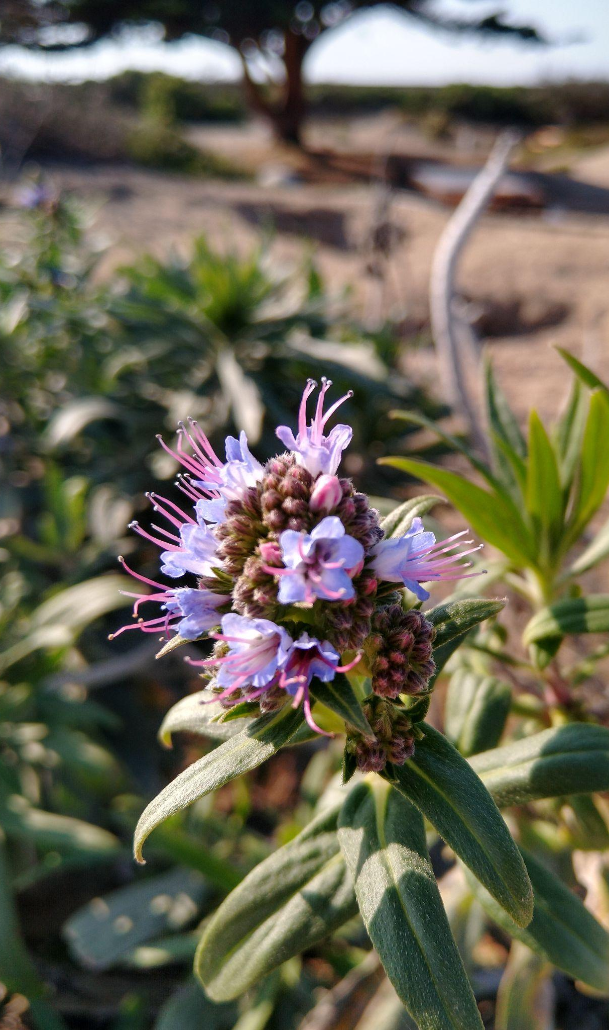
Eligible grant recipients
Nonprofit organizations
Tribal governments (both federally recognized and state-recognized) and intertribal consortia
Local governments
Institutions of Higher Education
Native American Organizations

Slide 13
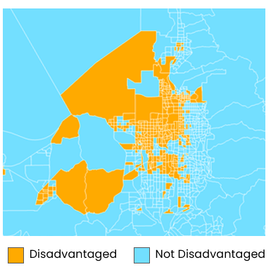
Grant Eligibility: Benefits Communities of Focus
Project activities must benefit communities of focus as defined by Inflation Reduction Act (IRA) Disadvantaged Communities Map.
How to Create a Project Map Using EJ Screen:
https://www.youtube.com/watch?v=MMeIpWAlLtE
Source: https://www.epa.gov/environmentaljustice/inflation-reduction-act-disadvantaged-communities-map
*If your community is not reflected in the IRA Disadvantaged Communities Map you may still be eligible for this grant. Please contact us at mapejgrants@jsi.com

Slide 14
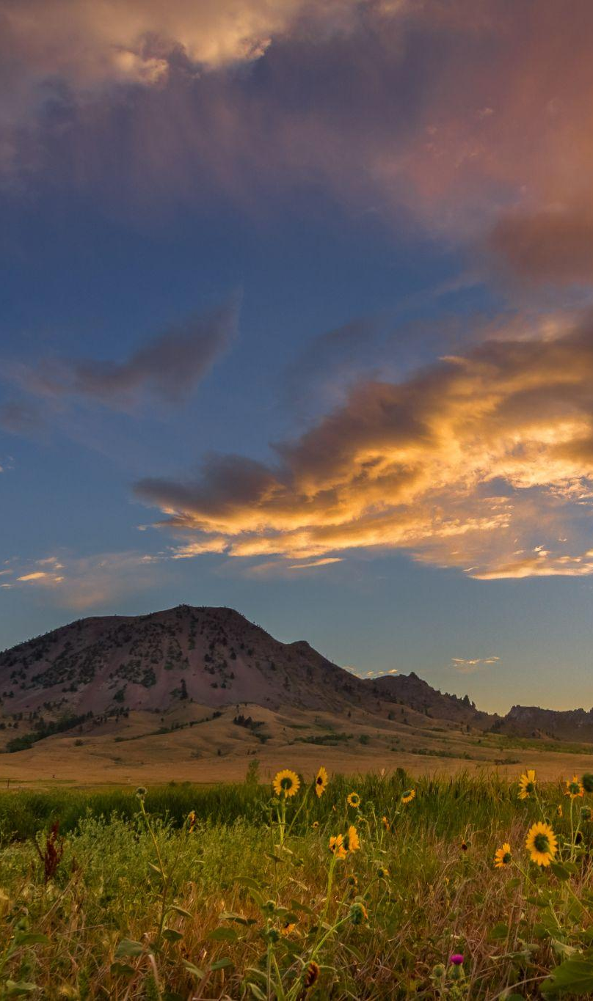
We anticipate three cycles of grant applications
Applicants can apply to multiple cycles
A single applicant can receive up to 2 awards for a total of up to $600,000
Additional things to know

Slide 15
Tentative Timeline for Applications
Cycle 1:
Oct 28 - Dec 12, 2024
Cycle 3:
Fall 2025
Cycle 2:
Spring 2025
NOTE: Timelines are subject to change. Please check mapejgrants.org for more up to date information.

Slide 16
Possible Project Topics
Air quality & asthma
Fence line air quality monitoring
Monitoring of effluent discharges from industrial facilities
Water quality & sampling
Small cleanup projects
Improving food access to reduce vehicle miles traveled
Stormwater issues and green infrastructure
Lead and asbestos contamination
Pesticides and other toxic substances
Healthy homes that are energy/water use efficient and not subject to indoor air pollution
Illegal dumping activities, such as education, outreach, and small-scale clean-ups
Emergency preparedness and disaster resiliency
Environmental job training for occupations that reduce greenhouse gases and other air pollutants
Environmental justice training for youth
Other community-driven environmental justice priorities

Slide 17
Projects you might not realize are EJ
Workshops on safe and sustainable farming practices
Solar microgrids
Climate assessments as part of CHW outreach
Weather shelters at bus stations in rural areas
Green infrastructure improvement (e.g. rain barrels, rain gardens)
Food source preservation for communities/ species conservation and biodiversity
Permaculture
EJ-themed mural project with youth
Patient-centered climate resilience training and tools
Plan for increasing community involvement in a county Climate Action Plan
Citizen science: Collecting data from community members about the urban health environment
Workforce capacity development for green jobs
Tree planting and restoration
Other community-driven environmental justice priorities

Slide 18
Case example A
Org type: Non-profit organization
Project description: A non-profit organization is working with a local Tribe to better understand the need, desire, and potential barriers to supporting residential solar to increase energy independence of the Tribe. They propose a combination of Tribal community engagement through surveys, focus groups, and community meetings, as well as public education.
Project Tier: 1
In their application, the nonprofit describes their longstanding relationship with the Tribe, the Tribe’s support of this proposal, and the specific EJ issue that the project will address.

Slide 19
Case example B
Org type: Health center
Project description: Health center staff want to develop a training plan for integrating climate resilience into health center operations and care delivery to better serve patients and communities.
Project Tier: 2 or 3
In their application, the health center describes how the trainings will address an explicit environmental justice issue in their community, the IRA disadvantaged community that the plan will impact, and how they will meaningfully engage that community in the design and execution of the plan.

Slide 20
Case example C
Org type: Community-Based Organization (CBO)
Project description: An agriculture-focused CBO in a rural area is proposing a program that supports local farmers to transition towards sustainable farming practices.
Project Tier: 3
In their application, the CBO describes their existing relationship with farmers in the area, the expressed needs and desire of the local farmers to transition their current farming practices, and how they will meaningfully engage the farmers in the design and delivery of the program.

Slide 21
Additional Considerations
Land Acquisition and Purchase
Fiscal Sponsorship
Human Subjects Research
Construction
Quality Assurance Project Plans
FAQ: https://mapejgrants.org/faqs/

Slide 22
Quality Assurance Project Plan
If you are proposing a project that involves collecting environmental data you may be required to complete a Quality Assurance Project Plan (QAPP)
The QAPP includes detailed descriptions of your data collection and analysis processes and quality assurance practices.
Your QAPP must be reviewed and approved by the EPA before you can begin the data collection.
Developing a QAPP can be time and resource intensive. It is helpful to have support from someone who is experienced with QAPPs.
Please reach out to mapejgrants@jsi.com if you have questions about QAPPs or projects that require them.

Slide 23

Application Overview

Slide 24
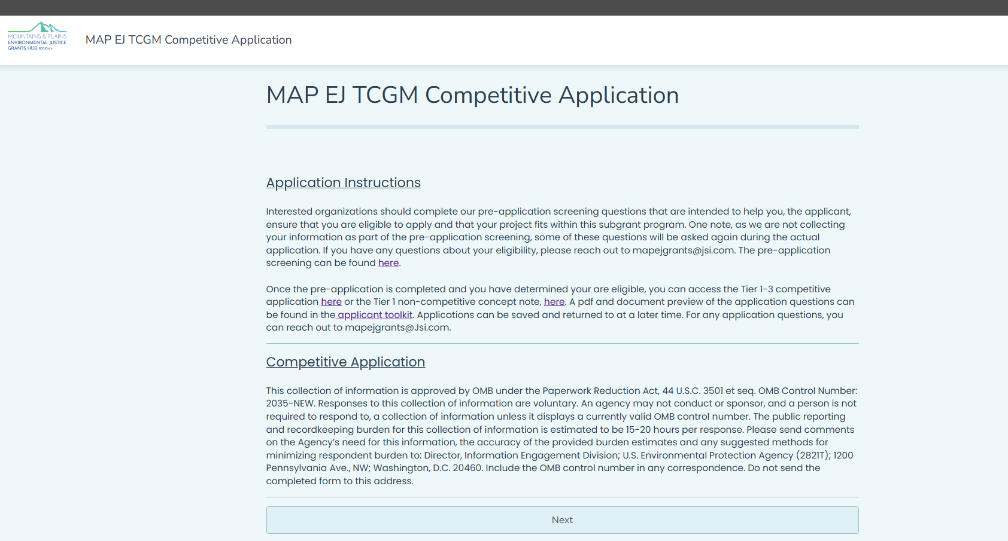
Competitive and Non-competitive Application

Slide 25
Competitive Application Weighted Scoring
Section | Weighting | Min Score | Max Score
Applicant Profile | x1 | 1 | 5
Need and Centering Community | x3 | 3 | 15
Partnerships, Assets and Meaningful Community Engagement | x4 | 4 | 20
Project Goals, Activities, and Milestones | x4 | 4 | 25
Performance Measures & Sustainability | x3 | 3 | 15
Programmatic Capability | x2 | 2 | 10
Budget & Budget Narrative | x2 | 2 | 10
TOTAL |  | 19 | 100

Slide 26
Competitive Application Scoring Rubric Summary
Applicant Response | Score | Recommendation
The applicant is not responsive to the application questions. | 1 | Not recommended for funding.
The applicant has proposed a project that does not align with the goals and principles of the Thriving Communities Grantmaker Program, the applicant doesn’t effectively convey how they will address an environmental justice issue in a way that benefits a community of focus, and/or the applicant does not demonstrate the capacity to complete the project as described. | 2 | Not recommended for funding.
The applicant has proposed a project that is intended to address an environmental justice issue in a community of focus, but there are capacity concerns, gaps in the project design, or issues with the project approach that may impact its success. | 3 | Possibly recommended for funding; may need technical support.
The applicant has proposed an attainable project that is intended to address an environmental justice issue in a community of focus, has plans to effectively engage impacted communities, and demonstrates capacity to achieve project goals. | 4 | Recommended for funding.
The applicant has proposed a community-driven project that will effectively address the environmental justice issue described. The applicant demonstrates the capacity to successfully achieve project goals and has articulated how this project fits into a broader community environmental justice strategy. | 5 | Recommended for funding.

Slide 27
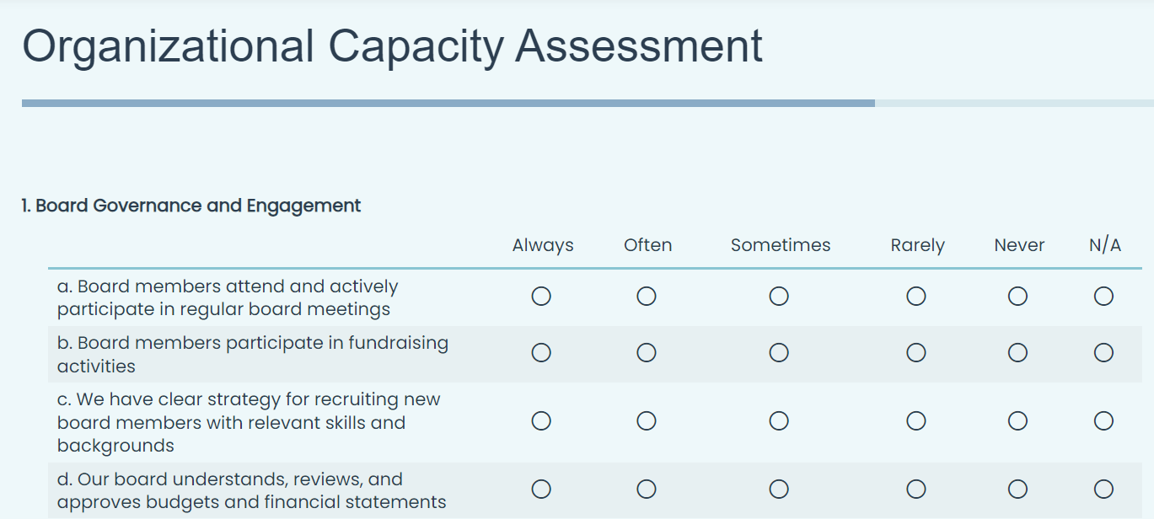
The Non-Competitive Application

Slide 28
Additional Resources
All of the application details are available on our website, mapejgrants.org.
The Environmental Protection Network (EPN) has many resources available, including every other week office hours on UEI assistance

Slide 29

Technical Assistance: MaPTCC
MaPTCC can help you:
Develop and prepare your application
Determine the most appropriate MAP EJ Grants tier for your project
Help plan your project step-by-step
Connect with experts in your field of interest
Network with groups doing similar work
Identify resources for proposal development
MAP EJ Grants Hub can help you:
Answer technical and logistical questions about the program
Unique Entity ID (UEI) acquisition process
Other grant-specific questions
Providing post-award technical assistance on:
Workplan development
Program implementation challenges
Reporting requirements
https://www.montana.edu/thrivingcommunities/

Slide 30
Q&A

Slide 31

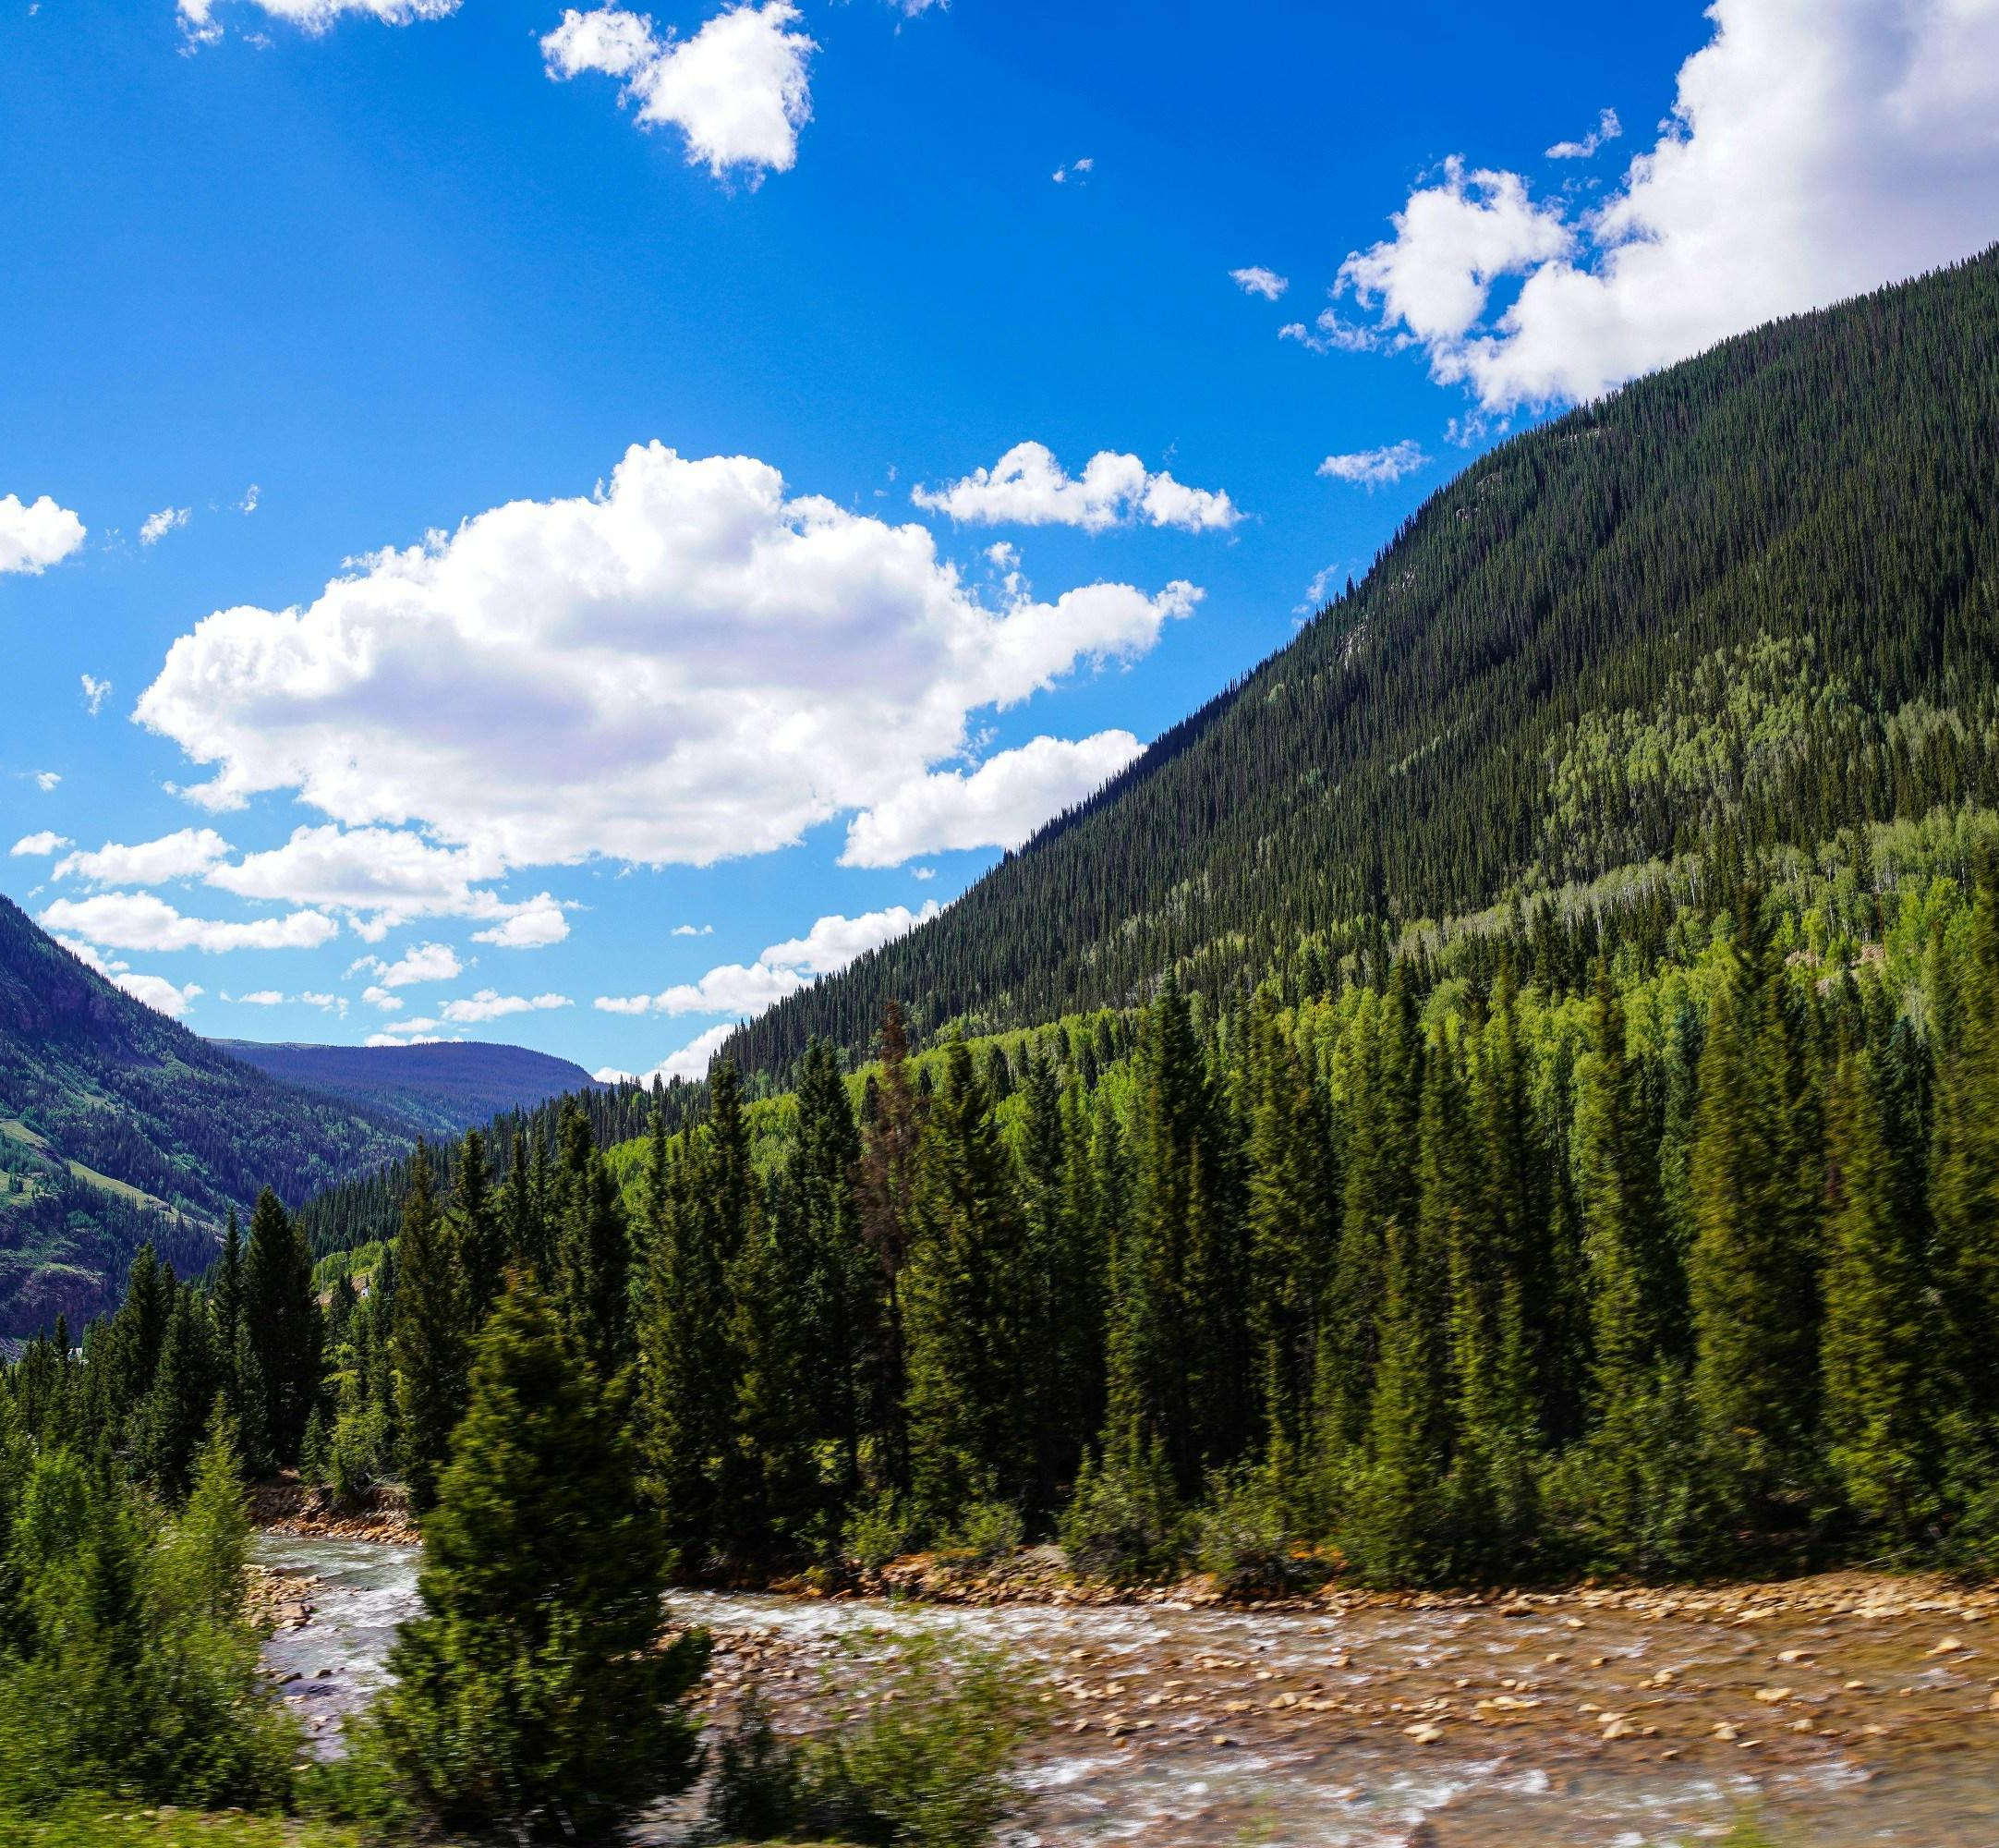
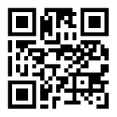
Contact Us
For any questions or more information, please email mapejgrants@jsi.com
Visit mapejgrants.org for more information
Disclaimer Statement: The Mountains and Plains Environmental Justice Grants Hub is supported by funding from the U.S. Environmental Protection Agency under cooperative agreement 00150001. The information does not necessarily reflect the views and policies of the U.S. Environmental Protection Agency.

