Slide 1
An EPA Thriving Communities Initiative
Cycle 1 Application Launch & Overview
November 2024
Notes:
Any time we are meeting with community it is an opportunity to build relationships.
Intro (include your name, position and something you want to share like why you are in EJ)
Invite them to introduce themselves

Slide 2
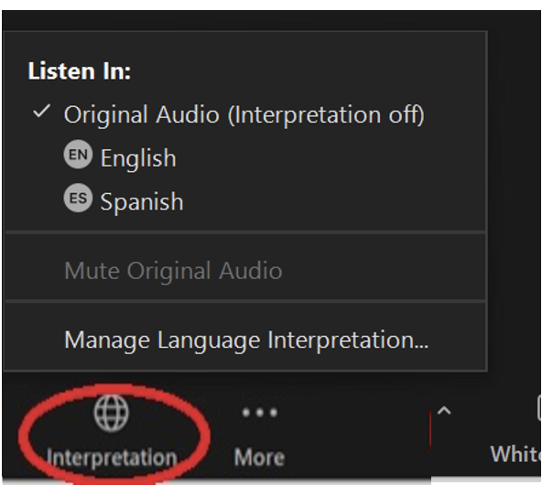
Simultaneous interpretation is available in Spanish
For Spanish interpretation:
In your meeting/webinar controls,
click Interpretation
Click the language that you would
like to hear.
(Optional)
To hear the interpreted language
only, click “Mute Original Audio”
Para traducción al español:
Haz clic en “Interpretación” en la
configuración/controles de la reunión
Elija su idioma preferido
(Opcional)
Para escuchar solo el idioma
interpretado, haga clic en “mute
original audio (silenciar audio original)”
Notes:
Shaivi

Slide 3
Closed Captioning is available
To enable closed captioning, click on the “CC” icon in your meeting/webinar controls.
Select “Show Captions”
Notes:
Shaivi

Slide 4
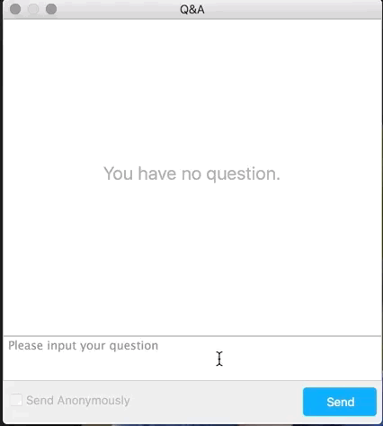
How to Ask a Question
Two ways to ask a question:
Use the Q&A box at the lower-left of your screen to chat with the presenter.
You may also email questions to mapejgrants@jsi.com after the webinar.
Notes:
Shaivi

Slide 5
Agenda
Introduction to TCGM
Who are we?
What do we do?
Grant Overview
Tiers
Eligibility
Timeline
Additional considerations
Application Overview
Competitive
Non-competitive
Notes:
Alexia
Objectives:
Inform participants
Explain the criteria and the application process provide resources

Slide 6
Overview: EPA Thriving Communities Grantmaking Program
Purpose: to reduce barriers and make it easier for small, community-based organizations to access federal environmental justice funds
Funding: $600 million from Inflation Reduction Act (IRA), the largest investment in climate action in history.
Who and what: Nationally 11 grantmakers covering all EPA regions will distribute thousands of grants over 3 years.
Notes:
Alexia
High-level overview of the EPA Thriving Communities Grantmaking Program

Slide 7
Overview: MAP EJ Grants Hub Team
Who we are?
JSI Research & Training Institute, Inc. (Denver, CO) & community-based partner organizations across EPA Region 8.
Notes:
Alexia
JSI Is a global nonprofit dedicated to improving lives around the world through greater health, education, and socioeconomic equity for individuals and communities. This project is based out of our Denver, CO office. JSI with our partner community based organization make up the Mountains and Plains Environmental grants Hub.

Slide 8
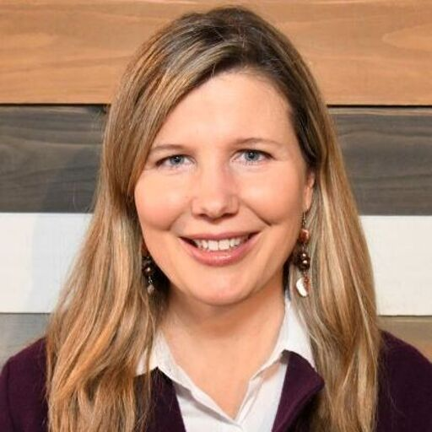
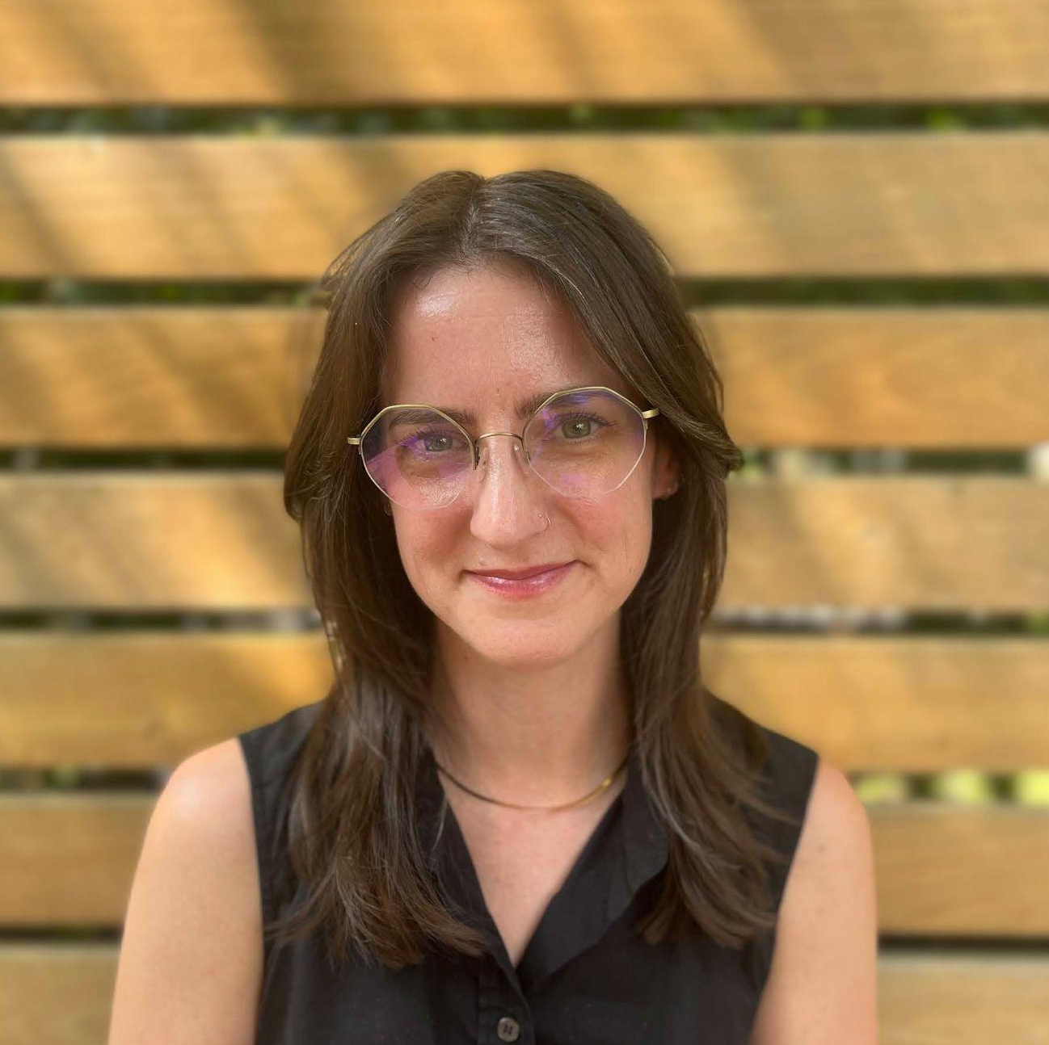
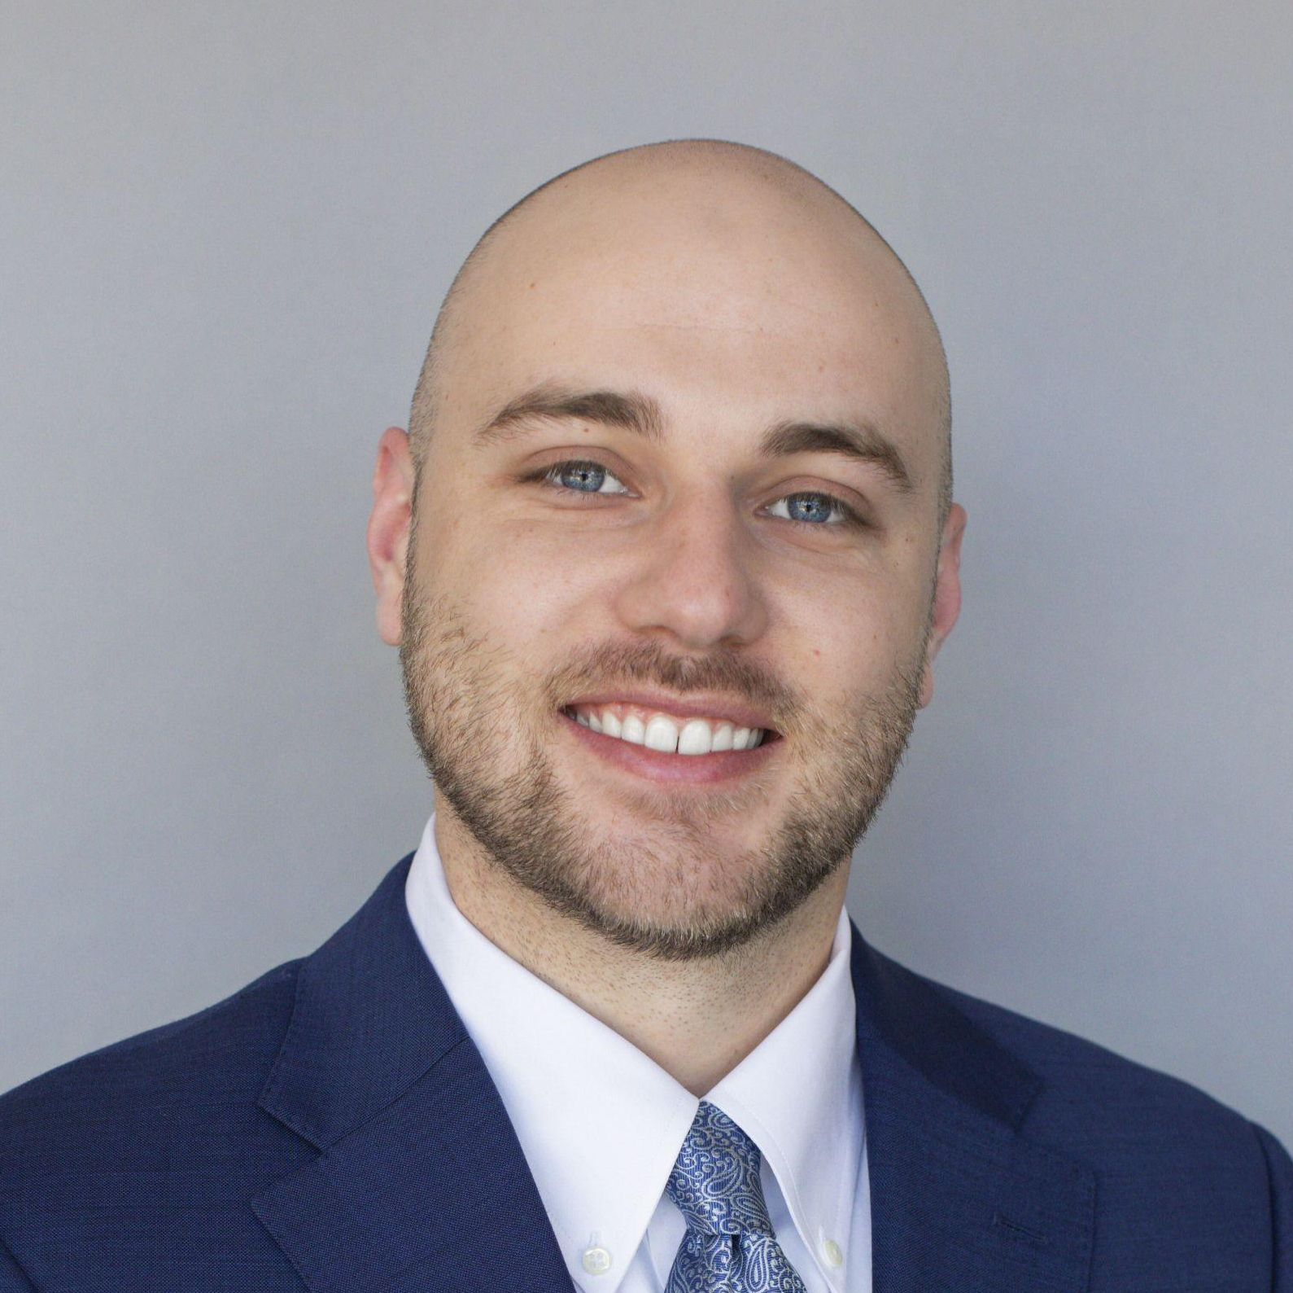
Meet the Team
Alexia Eslan
Project Director
Elizabeth White
Deputy Director
Meredith Lee
Grantmaking Director
Meghan Guevara
Senior Grant Manager
MT Grant Manager
Lesly Fajardo-Feaux
Senior Grant Manager
ND Grant Manager
Ali Witonsky
CO Grant Manager
John Karikas
WY Grant Manager
Molly Rafferty
SD Grant Manager
Savannah Smith
Tribal Grant Manager
Natalie Youssef
UT Grant Manager
Notes:
Alexia:
GM team and their respective states
Ask GM to come onto camera and wave.

Slide 9
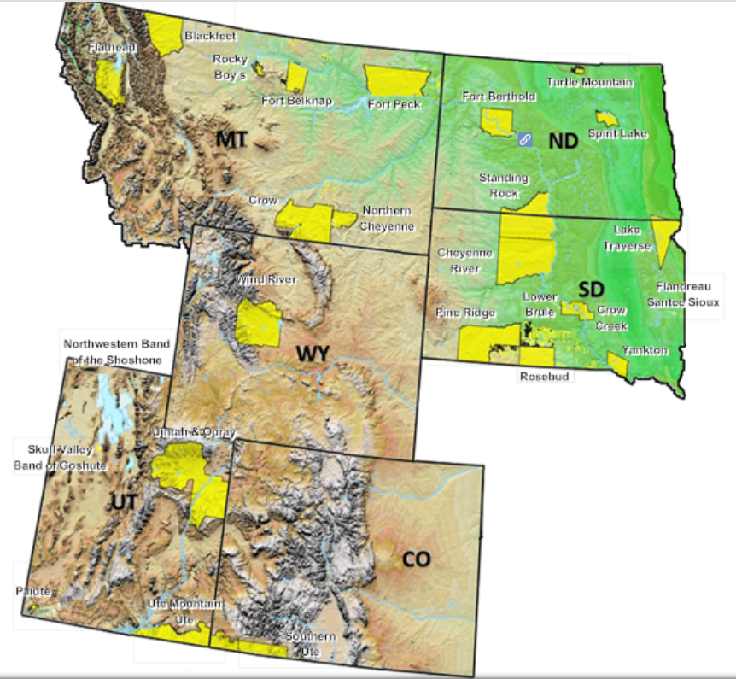
Overview: MAP EJ Grants Hub
Purpose: Provide $40 million in grants over 3 years to communities across EPA Region 8 (CO, MT, ND, SD, UT, WY, 28 Tribes) working on environmental justice efforts.
Goals:
Get money and resources to the environmental justice communities
Reduce the burden of getting and managing a federal grant
Strengthen the capacity of local organizations to support long-term sustainability
EPA makes no claim regarding the accuracy or precision of the data shown herein. This map is intended for reference purposes only and does not necessarily represent EPA’s position on Indian reservation boundaries or the Indian country status of any specific location.
Notes:
Alexia:
Overview of MAP EJ Grants Hub
Over the next three years we will be providing $40M in grants to communities across EPA Region 8, including Colorado, Montana, North Dakota, South Dakota, Wyoming, and 28 federally recognized tribes.
The goals of this program are
first and foremost to get money and resources to the environmental justice communities on the ground who need this money the most. We want to make sure that communities who have historically and contemporarily been underinvested can benefit form this program and that they can use this program as a launching pad for future work.
Make it easier for especially smaller community based organizations to get and manage federal funds. we know that federal funds come with lots of strings attached and that it can be extremely challenging and as expensive to try and navigate federal funding. Our job as the grant maker is to support our grantees to try and reduce the barrier to get the funds and then make it less painful to manage the funds once you have them. These are still federal funds, so there are restrictions and reporting requirements that are applicable to this funding, and it’s important to understand what these are. We will be covering many of them during our webinar today.
Finally, we want to support organizations to be sustainable and to strengthen their capacity broadly speaking so that you can go on to get more federal and non-federal grants. This is partially also why we have developed this program to allow for grantees to receive multiple awards from us (more to come on this later)
Add language: we are not able to give advice

Slide 10
Grant Overview
Notes:
Meredith

Slide 11
Eligible Grant Activities
Tier 1 Grants: Assessment | up to $150,000 | 1 Year
Examples include: Research (that is incidental to the project design) • Sampling • Testing • Monitoring
• Investigations • Surveys and studies • Public education
+ Pilot ten $75,000 noncompetitive fixed amount awards for severely capacity-constrained organizations
Tier 2 Grants: Planning | up to $250,000 | 1-2 Years
Examples include: Planning • Partnership-building • Public outreach and education • Coordination with community stakeholders to address environmental issues • Training activities for community organizations and community members • Projects and activities to spur community involvement (e.g., cleanups of vacant lots) • Smaller land purchases and acquisitions that require less than half of the total amount of subgrant funding
Tier 3 Grants: Development | up to $350,000 | 2 Years
Examples include: Project Development • Blueprints for construction or cleanup projects, schematics, and technical development • Work to get permits in place directly related to an environmental project • Smaller land purchases and acquisitions that require less than half of the total amount of subgrant funding • Implementation of project plans • Public outreach and education
Notes:
Meredith
We are offering 3 tiers of grants: (read slide)
Non-competitive awards: We are offering approximately 10 non-competitive tier 1 awards of $75k for severely capacity constrained organizations. These grantees will work closely with one of our grant managers to co-design the workplan together and then these grants will be milestone based in terms of payment.
What does severely capacity constrained me? I think of these are organizations who may have just received their 501c3 status. Or maybe they’ve been around for a little while, but they don’t have any paid staff or maybe just one or two staff. Or maybe it is an organization who has never received a grant before.
As this is a pilot, we do have only a limited number. Decisions will be made on a number of factors including geography, we want to ensure geographic diversity across the region, as well as relative capacity.

Slide 12
Possible Project Topics
Air quality & asthma
Fence line air quality monitoring
Monitoring of effluent discharges from industrial facilities
Water quality & sampling
Small cleanup projects
Improving food access to reduce vehicle miles traveled
Stormwater issues and green infrastructure
Lead and asbestos contamination
Pesticides and other toxic substances
Healthy homes that are energy/water use efficient and not subject to indoor air pollution
Illegal dumping activities, such as education, outreach, and small-scale clean-ups
Emergency preparedness and disaster resiliency
Environmental job training for occupations that reduce greenhouse gases and other air pollutants
Environmental justice training for youth
Other community-driven environmental justice priorities
Notes:
Meredith
There are a wide range of project topic areas that you can consider. This list is not exhaustive! (read some from the list)

Slide 13
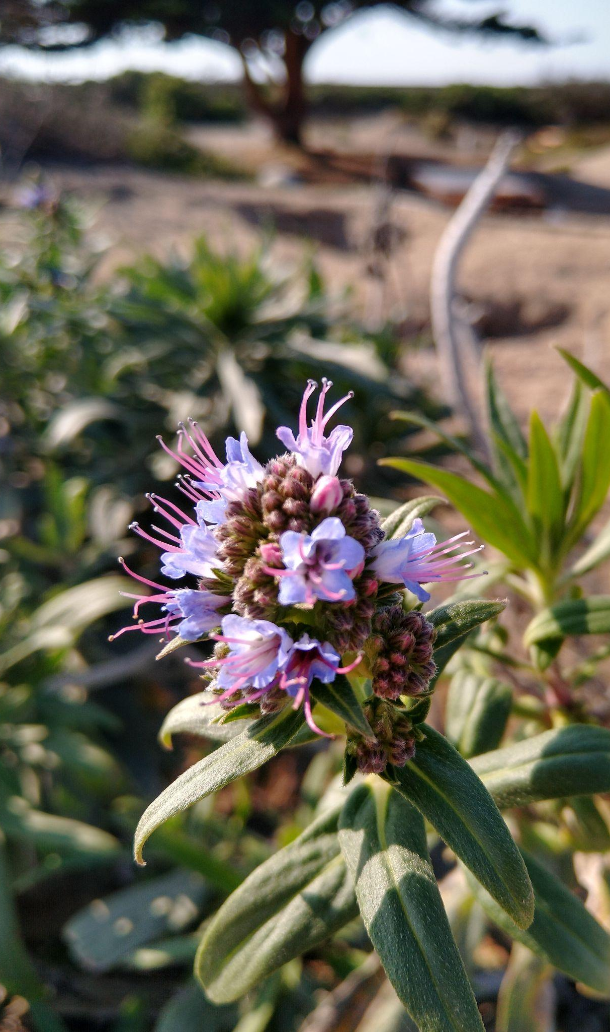
Eligible grant recipients
Nonprofit organizations
Tribal governments (both federally recognized and state-recognized) and intertribal consortia
Local governments
Institutions of Higher Education
Native American Organizations
Notes:
Meredith
Who is eligible for our grants:
Read from slide

Slide 14
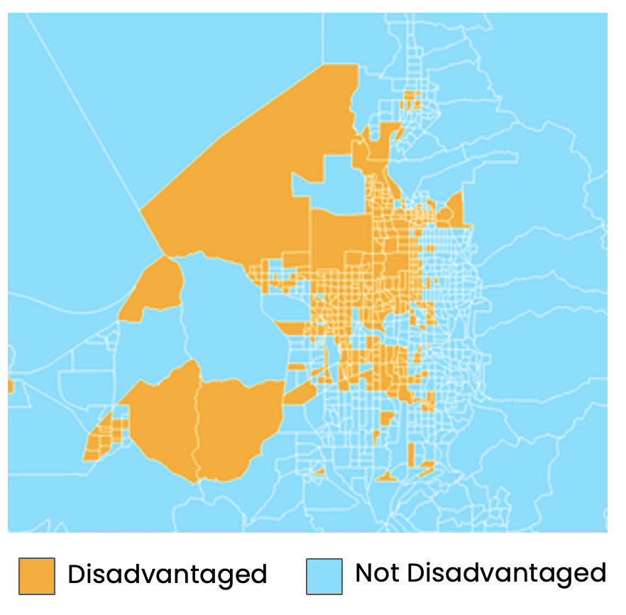
Grant Eligibility: Benefits Communities of Focus
Project activities must benefit communities of focus as defined by Inflation Reduction Act (IRA) Disadvantaged Communities Map.
How to Create a Project Map Using EJ Screen:
https://www.youtube.com/watch?v=MMeIpWAlLtE
Source: https://www.epa.gov/environmentaljustice/inflation-reduction-act-disadvantaged-communities-map
*If your community is not reflected in the IRA Disadvantaged Communities Map you may still be eligible for this grant. Please contact us at mapejgrants@jsi.com
Notes:
Meredith
Grants must also benefit communities of focus as identified by the Inflation Reduction Act Disadvantaged Communities Map. This website here will take you to a map where you can see if your community is designated as disadvantaged by this tool. If your community is not reflected in this map you may still be eligible. We encourage you to reach out to our team to discuss in more detail.
Disadvantaged communities are defined by EPA as a population or geographic location in the United States that experiences disproportionate environmental and climatic harms and risks. This disproportionality can be a result of greater vulnerability to environmental hazards, lack of opportunity for public participation or other factors. Increased vulnerability may be attributable to an accumulation of negative or lack of positive environmental, health, economic or social conditions within these populations or places.
Add more about how DAC are defined.
Don’t necessarily need to say this, but in case you get questions:
The IRA DAC tool includes
Any census tract that is included as disadvantaged in the Climate and Economic Justice Screening Tool (CEJST). CEJST includes any census tract that is
at or above the threshold for one or more environmental, climate, or other burdens, and
at or above the threshold for an associated socioeconomic burden.
is completely surrounded by disadvantaged communities and is at or above the 50% percentile for low income is also considered disadvantaged.
Any census block group at or above the 90th percentile for any of EJScreen’s Supplemental Indexes when compared to the nation or state,
and/or any of the following geographic areas within the Tribal lands category in EJScreen:
Alaska Native Allotments
Alaska Native Villages
American Indian Reservations
American Indian Off-reservation Trust Lands
Oklahoma Tribal Statistical Areas

Slide 15
Additional things to know
We anticipate three cycles of grant applications
Applicants can apply to multiple cycles
A single applicant can receive up to 2 awards for a total of up to $600,000
Notes:
Meredith
A few more things to know! (read slide)
For example, this means that you can get a tier 1 application during cycle 1 and then apply and receive a tier 2 applications in cycle 3. Or a tier 2 in cycle 2 and a tier 3 and cycle 3. The total award amount just can’t be over $600k (which means that you won’t be able to receive 2 tier 3 awards). This also means that if you receive a tier 1 non-competitive in cycle 1 or 2 that you could come back for a competitive award in a later cycle as well!

Slide 16
Tentative Timeline for Applications
Cycle 1:
Oct 28 - Dec 12, 2024
Cycle 3:
Fall 2025
Cycle 2:
Spring 2025
NOTE: Timelines are subject to change. Please check mapejgrants.org for more up to date information.
Notes:
Meredith
In terms of timeline, we are anticipating releasing cycle 1 October 28, which will close by December 12, 2024. the subsequent cycles will be in the spring of 2025 and then the fall of 2025
this project is for three years, but the allocation is only 2 years.

Slide 17
Additional Considerations
Land Acquisition and Purchase
Fiscal Sponsorship
Human Subjects Research
Construction
Quality Assurance Project Plans
FAQ: https://mapejgrants.org/faqs/
Notes:
Meredith
As you plan your project, we wanted to raise a few specific considerations.
If you are planning to propose a land purchase as part of a Tier 2 or Tier 3 proposal, please note that land purchases cannot exceed 50% of your overall project budget. ($125K or $175K)
If you are in a fiscally sponsored entity, please refer to the FAQ documents for special guidelines related to application restrictions, allowable expenses, and contracting, and please reach out to us if you have questions.
If you are selected to receive a subgrant, certain types of projects are subject to additional EPA requirements. We would recommend reviewing these requirements before you submit your proposal so that you’re aware of the steps that you might need to take, and so you can budget for these steps if needed.
Any projects that include Human Subjects Research must have the approval of an Institutional Review Board or IRB, and the research plan must also be approved directly by EPA.
Projects that include the collection or analysis of environmental information must have a Quality Assurance Project Plan, which needs to follow a specific format and must also be approved by EPA.
Projects that include construction, renovation, remodeling, etc. are subject to federal requirements regarding the procurement of materials and fair labor practices.
If you are proposing a project that includes any of these components, please refer to our FAQ document for more information, and you can also reach out to us for more details on these requirements.

Slide 18
Quality Assurance Project Plan
If you are proposing a project that involves collecting environmental data you may be required to complete a Quality Assurance Project Plan (QAPP)
The QAPP includes detailed descriptions of your data collection and analysis processes and quality assurance practices.
Your QAPP must be reviewed and approved by the EPA before you can begin the data collection.
Developing a QAPP can be time and resource intensive. It is helpful to have support from someone who is experienced with QAPPs.
Please reach out to mapejgrants@jsi.com if you have questions about QAPPs or projects that require them.
Notes:
Meredith
Applicants planning to collect, produce, or use environmental data—such as for air, water, or soil samples—must develop a Quality Assurance Project Plan (QAPP). This detailed plan outlines how data will be gathered, analyzed, and assessed to meet quality standards and must be approved by the EPA before project initiation.
The development of QAPPs may require a significant investment of time and labor on the part of grantees. Applicants are welcome to include resources necessary to support QAPP development in their project budget and workplan. We are also working with the EPA and other grantmakers to compile QAPP resources and determine what support we can offer as grantees develop QAPPs. We are awaiting a decision tree resource from EPA about how to decide whether a project needs a QAPP, and we will post that on our website as soon as it is available.
Note that creating a QAPP can be time-consuming, and additional technical assistance or consulting may be necessary within your budget. Regular reviews and updates to the QAPP will also be required to ensure ongoing effectiveness
QAPPs need to be written and submitted by March/April 2025

Slide 19
Application Overview
Notes:
Meghan
Now we’re going to get into a bit of detail about the applications themselves, and how they will be evaluated.

Slide 20
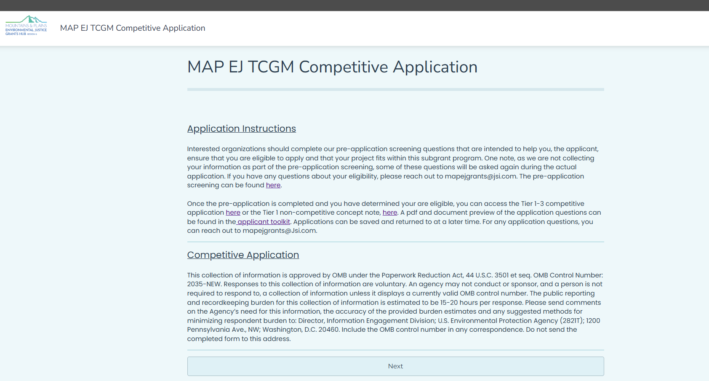
Competitive and Non-competitive Application
Notes:
Meghan
As we’ve mentioned, there are two types of applications available–a non-competitive application that is intended for severely capacity constrained organizations, and a competitive application for all other applicants.
Both applications were designed to be straightforward and relatively brief. There is no need to engage with grants.gov or any other federal portals; you will apply directly to the MAP EJ Grants Hub, and we did not intend for this to require a professional grantwriter.
Both applications will be available in English and Spanish through an online portal beginning on the 28th. There are pdf versions available in English and Spanish on our website now for anyone who would like a preview.
Applications can also be submitted via mail; mailed applications must be postmarked by December 12th.
There are instructions included with the application, and there is also a more detailed applicant guide available on our website.
The first section of both the competitive and non-competitive applications address eligibility requirements, so you’ll be asked to answer questions about your organization type, where your program will be taking place, and to what extent you are serving communities of focus.

Slide 21
Competitive Application Weighted Scoring
Section | Weighting | Min Score | Max Score
Applicant Profile | x1 | 1 | 5
Need and Centering Community | x3 | 3 | 15
Partnerships, Assets and Meaningful Community Engagement | x4 | 4 | 20
Project Goals, Activities, and Milestones | x4 | 4 | 25
Performance Measures & Sustainability | x3 | 3 | 15
Programmatic Capability | x2 | 2 | 10
Budget & Budget Narrative | x2 | 2 | 10
TOTAL |  | 19 | 100
Notes:
Now we’ll look at the sections of the competitive application and how it will be evaluated.
Applicants are asked to complete six narrative sections and budget. There is a word limit on each of the narrative sections which is intended to be enough to tell your story without being onerous.
[READ SECTIONS]
Three key themes throughout the application are the need to address an explicit environmental justice issue in an IRA disadvantaged community, and meaningful engagement of that community in the design and execution of the proposed project.
The budget section includes a spreadsheet template that details all of the costs being proposed. Applicants are also required to attach a budget narrative that describes each expense.
Each application will be reviewed by members of our Environmental Justice Council, which is comprised of community based organizations from across Region 8. Each section is scored on a scale of 1-5, and then each section is weighted. As you can see, the sections that have the highest weight are Partnerships, Assets and Meaningful Community Engagement and Project Goals, Activities, and Milestones. So for example, if you score a 4 on the Partnerships section, that will be multiplied by 4 for a weighted score of 16.

Slide 22
Competitive Application Scoring Rubric Summary
Applicant Response | Score | Recommendation
The applicant is not responsive to the application questions. | 1 | Not recommended for funding.
The applicant has proposed a project that does not align with the goals and principles of the Thriving Communities Grantmaker Program, the applicant doesn’t effectively convey how they will address an environmental justice issue in a way that benefits a community of focus, and/or the applicant does not demonstrate the capacity to complete the project as described. | 2 | Not recommended for funding.
The applicant has proposed a project that is intended to address an environmental justice issue in a community of focus, but there are capacity concerns, gaps in the project design, or issues with the project approach that may impact its success. | 3 | Possibly recommended for funding; may need technical support.
The applicant has proposed an attainable project that is intended to address an environmental justice issue in a community of focus, has plans to effectively engage impacted communities, and demonstrates capacity to achieve project goals. | 4 | Recommended for funding.
The applicant has proposed a community-driven project that will effectively address the environmental justice issue described. The applicant demonstrates the capacity to successfully achieve project goals and has articulated how this project fits into a broader community environmental justice strategy. | 5 | Recommended for funding.
Notes:
Meghan
This slide provides a high level overview of the 1-5 scale that is used to score each section of the application.
Generally speaking, a response scores a 1 if it is not responsive to the question that his asked
A response would score a 2 if it does not align with the key goals of the TCGM program, which is addressing an environmental justice issue in a way that benefits a community of focus, or if the project that is proposed does not match the budget or capacity described.
Applicants that score predominantly 1s or 2s are unlikely to be funded.
A response would score a three if it’s aligned with the goals of TCGM, but the evaluators identify significant flaws in the design or approach. Projects that average scores of 3 may be funded, but they may require some adjustments to the scope or design.
Applications that average scores of 4 or 5 are likely to be recommended for funding. They address an environmental justice issue in a community of focus, they demonstrate meaningful community engagement, and there is the capacity to execute the project. Projects that score a 5 are also able to demonstrate how they fit into a broader community strategy.
Of course, since we don’t know how many applications we are going to receive, we do not know how competitive this process will be. In the final selection of subgrant recipients, we will consider scores, geographic diversity, and the extent to which projects benefit IRA disadvantaged communities.
If you are not selected for funding, you will have the opportunity to request feedback on your proposal.

Slide 23
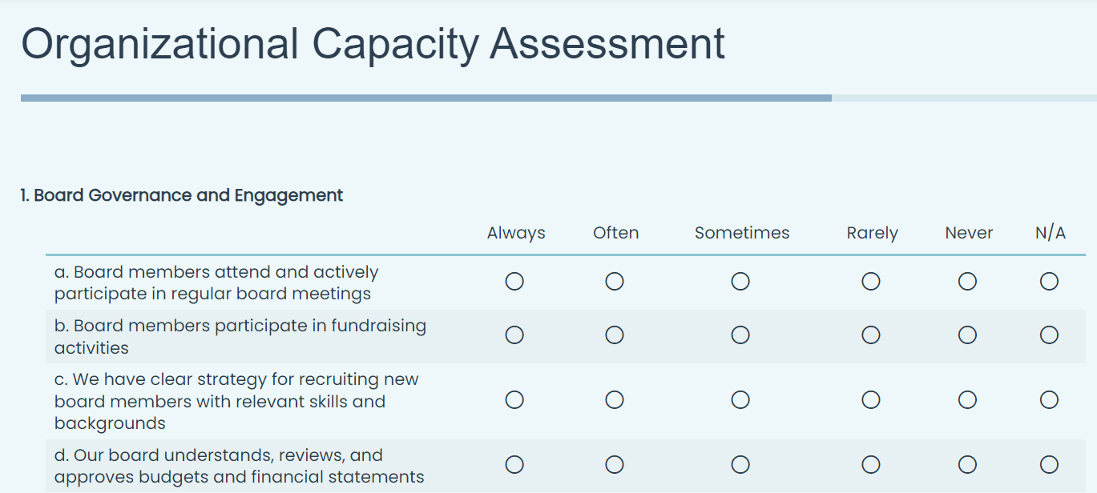
The Non-Competitive Application
Notes:
The pilot non-competitive applications will not be scored. When selecting finalists for non-competitive awards, we will consider both the project being proposed and the capacity of the organization. The application consists of 4 narrative questions, totally just over 800 words, for describing the proposed project. All noncompetitive awards are $75,000 fixed amount of awards, so a budget is not required with the application, but a budget will be required to enter into an award agreement.
The application also includes an organizational capacity assessments so that we can learn more about your organization’s governance,finances and fundraising, Staff and Infrastructure, Constituent Engagement 6. Diversity 7. Cultural Responsiveness 8. Organizational Strategy and Adaptability.
After submission, noncompetitive applicants will participate in a semi-structured interview to better understand your work and your capacity, and we may ask for some additional documentation in support of your organizationala assessment.
Final decisions will be based on organizational need and the alignment of the proposed project with program goals.

Slide 24
Additional Resources
All of the application details are available on our website, mapejgrants.org.
The Climate Justice Alliance is hosting a Quality Assurance webinar on October 29th
The Environmental Protection Network (EPN) has many resources available, including every other week office hours on UEI assistance
Notes:
Meghan

Slide 25
Technical Assistance: MaPTCC
The Mountains and Plains Thriving Communities Collaborative (MaPTCC) is the EPA funded TA provider for Region 8.
Services Offered through MaPTCC:
Figure out what your community needs most
Find the right grant for your project
Help you identify and use resources to develop a
proposal
Plan your project step-by-step
Connect with other groups doing similar work
And much more!
https://www.montana.edu/thrivingcommunities/
Notes:
Meghan
Finally, you don’t have to do this alone! The EPA is funding a separate technical assistance provider, the Mountains and Plains Thriving Communities Collaborative or MaPTCC. They offer a number of services including…read from slide.
One important thing to know about MaPTCC is that they are available to provide TA beyond the Thriving Communities grantmaking program (the one that we are talking abou there) they offer TA more broadly and can also help to connect you with other relevant federal funds if you are interested.
When you go to their website there is an online form that you fill out telling them a little bit more about you/your organization and what kinds of assistance you are looking for and then one of their COmmunity Resource and Education specialists will reach back out to you.

Slide 26
Q&A
Notes:
Shaivi–moderate

Slide 27
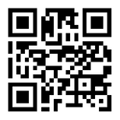
Contact Us
For any questions or more information, please email mapejgrants@jsi.com
Visit mapejgrants.org for more information
Disclaimer Statement: The Mountains and Plains Environmental Justice Grants Hub is supported by funding from the U.S. Environmental Protection Agency under cooperative agreement 00150001. The information does not necessarily reflect the views and policies of the U.S. Environmental Protection Agency.
Notes:
Finally, here is where you can find us online and how you can reach back out to us.

